Slide 1
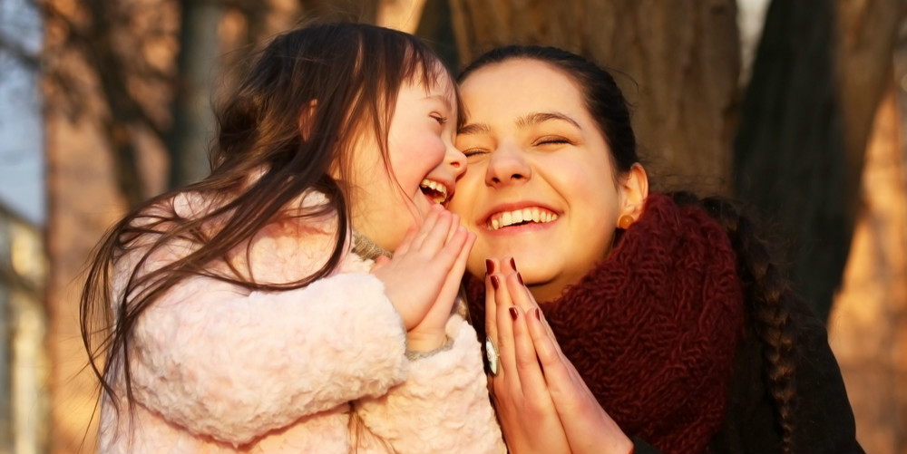
Please take a moment To pray for this weeks Prayer Requests

Slide 2
MARK ASHWORTH JUDY PUTERBAUGH FAMILY AND FRIENDS EARL SLONE

Slide 3
CHRONISTER FAMILY VIRGINIA BLACKFORD NANCY WRIGHT’S DAUGHTER TERESA THE YOUNT FAMILY

Slide 4
SCHOOL KIDS – LEARNING IN A DIFFERENT WAY

Slide 5
TEACHERS – LOVING THEIR STUDENTS FROM A DISTANCE

Slide 6
ELDERLY – SEEING THEIR FAMILIES ON TECHNOLOGY AND THROUGH THE WINDOWS

Slide 7
ESSENTIAL WORKERS- WORKING LONG HOURS, AND LOVING THEIR FAMILIES EVEN MORE

Slide 8
DECISION MAKERS- TO FOLLOW YOUR WORD AND YOUR WILL

Slide 9
A MOMENT FOR ALL THE UNKNOWN NEEDS OF OUR CHURCH FAMILY, FRIENDS, AND OUR COMMUNITY

Slide 10
WOMEN: TEACHING OUR KIDS WOMEN: WORKING TO SUPPORT THEIR FAMILIES WOMEN: THEIR HEARTS FULL WOMEN: TO HELP FOLLOW YOUR WORD OF THE LOVE THE WORLD NEEDS.

Slide 11
ANY PRAYER REQUESTS PLEASE CONTACT DARLENE OR JANET

Slide 12
